Slide 1















Lingua Vertex :
Language modeling with vertex ai
Team Spartan
Abdul Vahed Shaik
016452540

Slide 2

Introduction
•The daily use of data for a variety of objectives, including marketing, business, sentiment analysis, election prediction, and communication has increased rapidly.
• I employed language models to perform tasks like Text classification, Text summarization.
•I did this by fine-tuning the pretrained BERT model and leveraging GCP and Vertex Al to automate every stage of the ML system, including data collecting, model deployment, and serving.

Slide 3

Dataset used:
I have used below dataset:
Emotion from Hugging Face Dataset -
*The dataset is commonly used for emotion classification
* It is a dataset of Twitter messages
containing six basic emotions:
Anger
Fear
Joy
Love
Sadness
Surprise

Slide 4
Emotion Classification using Vertex Al
•By optimizing the pre-trained bert-base-cased model for the emotion classification task on Vertex AI, I have constructed an end-to-end training pipeline.
•The main objective for this task is to build, train, finetune and deploy a BERT based PyTorch model on Vertex Al
• We start by creating notebook instance on the GCP console

Slide 5

Cloud storage bucket
*THIS BUCKET AIDS IN STORING THE RESULTS OF HYPERPARAMETER TUNING AND MODEL ARTIFACTS.
*THIS IS USED IN THE MODEL CREATING AND DEPLOYMENT PROCESS ON VERTEX AI

Slide 6
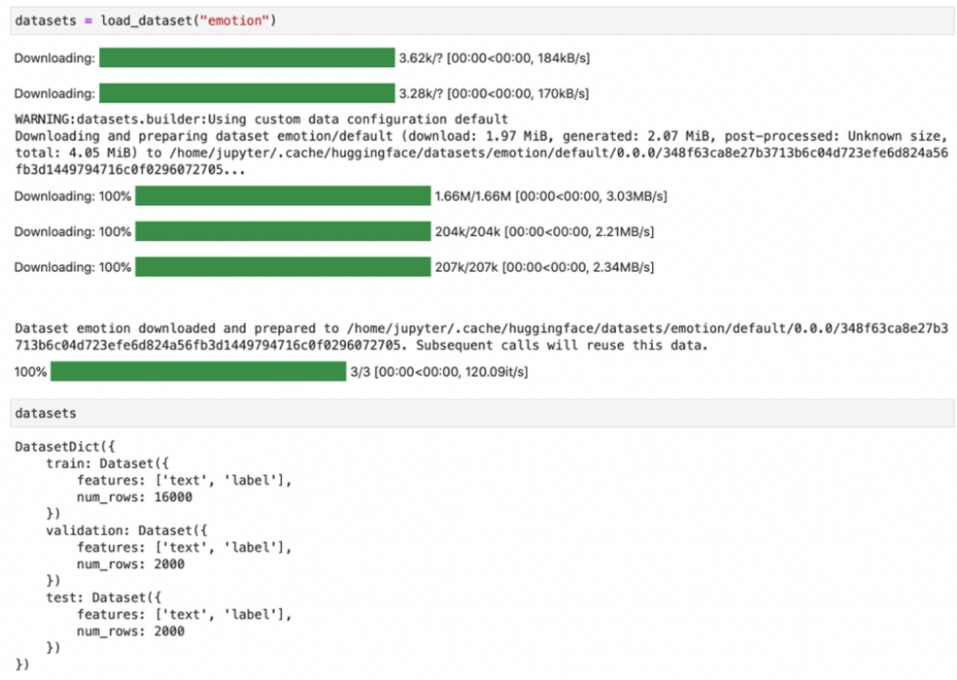
Model Training & Fine tuning - Dataset acquision
I started by downloading the emotion dataset using the Hugging Face Datasets library and then used the 'load_dataset' function to load the dataset.

Slide 7
Model Training & Fine tuning – Data Preprocessing
I preprocessed the incoming data to the format required by the model and tokenized it using the 'Tokenizer' class from Hugging Face Transformers.
A screenshot of some of the tokens used for text input is shown below:

Slide 8
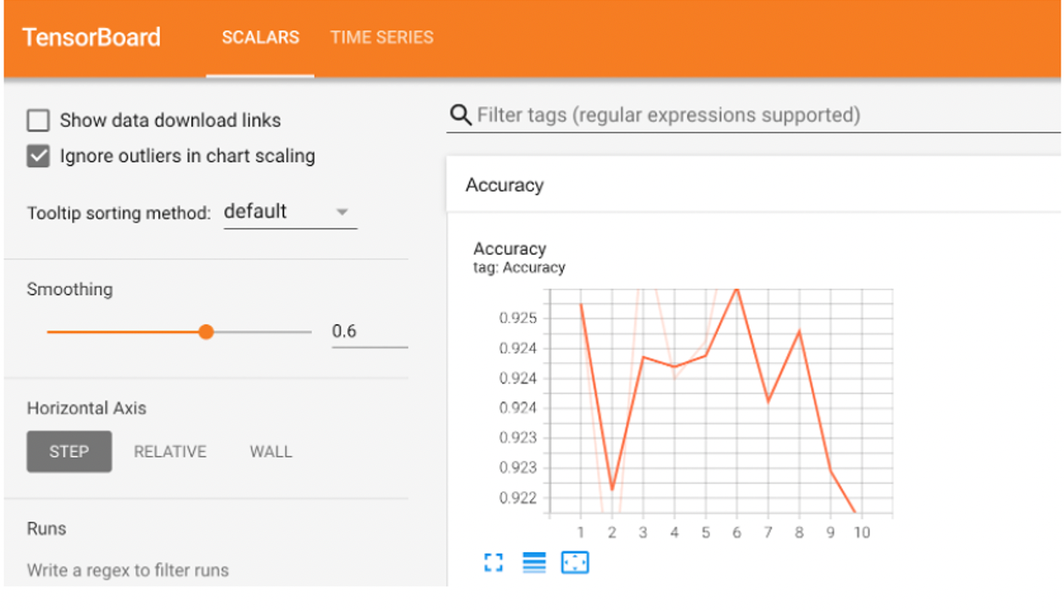
Fine-tuning the model locally:
I have swapped out the head that was used to pre-train it on masked language modeling tasks with a new head that is appropriate for emotion classification (5 labels as outputs).
This new head will be allocated when the model is fine-tuned and won't have pre-trained weights at first.

Slide 9
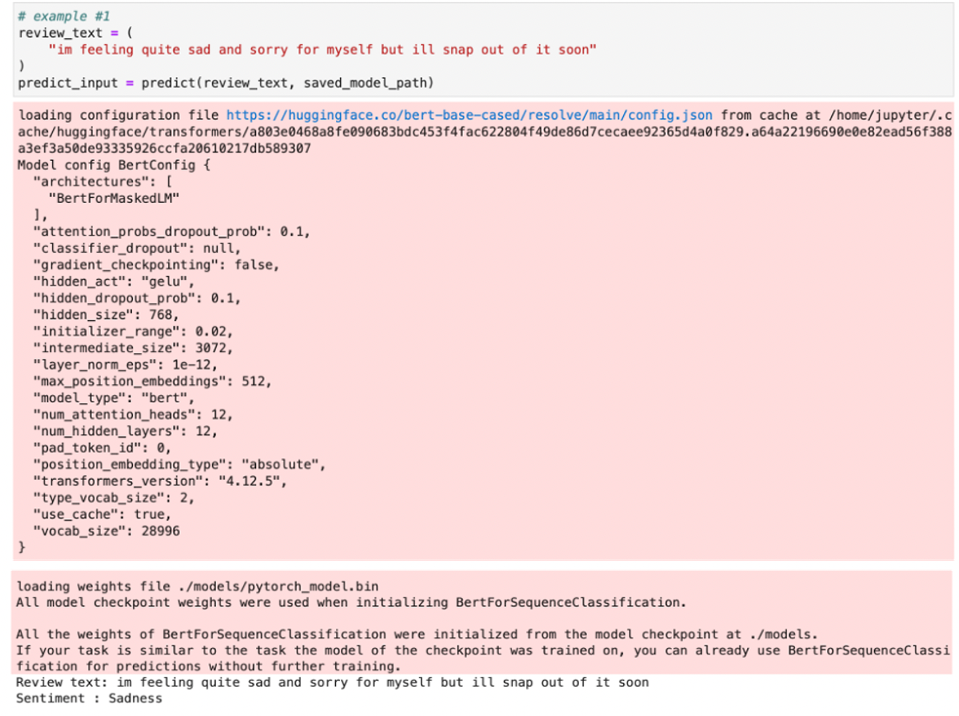

Slide 10

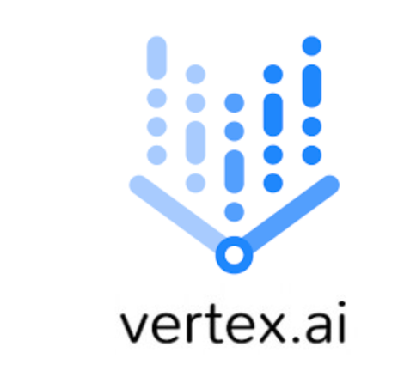
Training the model on vertex AI
Step 1:
The first step mainly involves packaging the training application code with all the dependencies and then uploading it to the cloud storage bucket.
We then submit the custom job from the notebook instance in order to run the training on GCP’s vertex AI platform

Slide 11

Continued
Step 2: Hyperparameter Tuning
I am fine-tuning the BERT model by experimenting with hyperparameters like learning rate and weight decay. I run the training application through several trials using the hyperparameter values as given (learning rate and weight decay).
Vertex Al records the outcomes of every trial done. This training application uses the cloudml-hypertune Python tool to send the metrics to Vertex Al.
When the task is finished, we receive a Pandas data frame with a summary of all the trial runs with the best-performing configurations based on all the parameters we set.

Slide 12
Deployment on Vertex Al:
I first packaged a customer container that was compatible with Vertex Predictions and packaged all the necessary model artifacts to serve the model.
I then pushed this model with a customized container image to serve predictions as a model resource on Vertex.
I created a Vertex endpoint and deployed the model resource models.

Slide 13
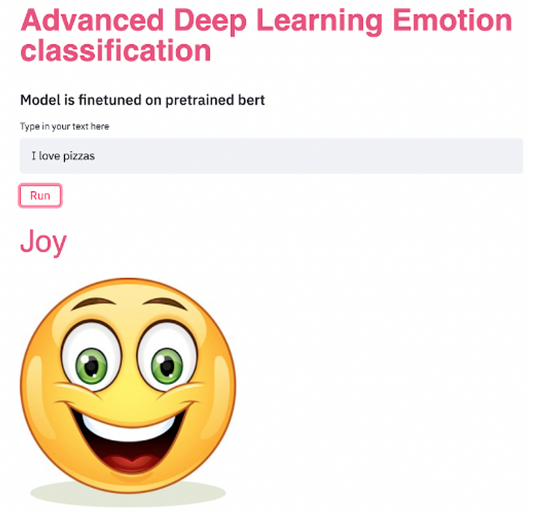
Evaluation & results
I have developed a Streamlit application to display the model's predictions on the user interface.
I utilized Google Cloud's 'aiplatform' module to provide the refined BERT model predictions on the Streamlit application.

Slide 14
Experiments

Slide 15
Text Summarization
Summarization is a language modeling task that reduces the length of a text document or summarizes it.
I employed HuggingFace's Pegasus model, which is specifically designed for financial statement summarizing.
trained manily on financial news and bloomberg market
Here, thw words that are carrying more weight are being highlightly in dark/thick colors.
Used some decoding strategies such as Top k sampling,Random sampling, Greedy Search, Beam Search, Diverse Beam Search,

Slide 16
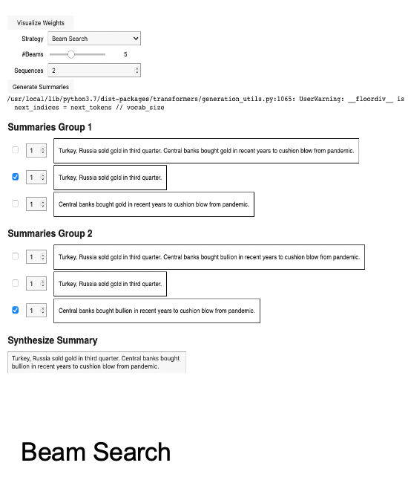
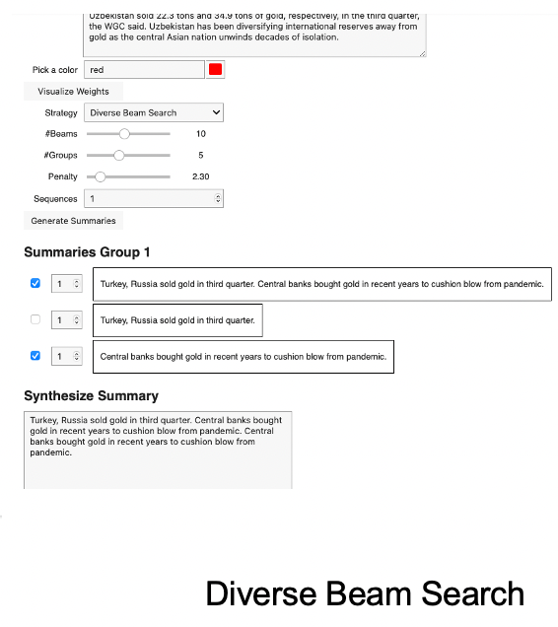

Slide 17
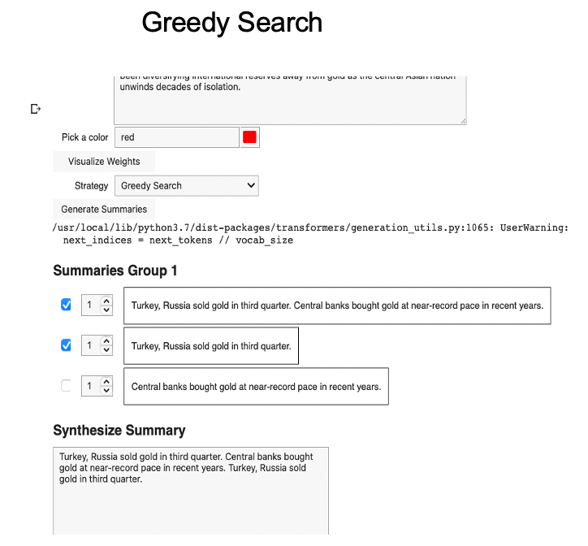
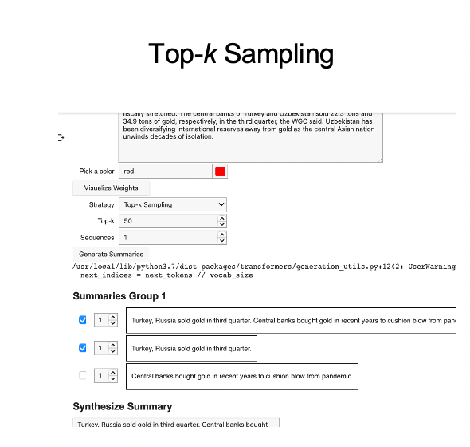

Slide 18

Challenges faced
Model Training: Since it is a Large language model, it was a quite time consuming to train and analyse the model.
Hyperparameter tuning: Finding the right set of hyperparameters was a bit challenging since I was required to run multiple trials of them.

Slide 19
Idea for future extension
Multimodal Integration
Image and Text Fusion: I have an idea of expanding the model's capabilities by integrating image recognition. I may try training it on paired text and image data to analyze images and generate relevant descriptions, translate captions, or answer questions based on both visual and textual cues. [Image depicting a language model processing an image and text simultaneously, generating a combined output]

Slide 20

Conclusion
I was able to effectively deploy the model to the Vertex Al endpoint and receive the predictions by calling the model endpoint from streamlit.
Through this project, I've deepened my understanding of language models, their capabilities, and limitations. I’ve also learned about training data, bias mitigation, and model interpretability.

Slide 21


